Slide 1
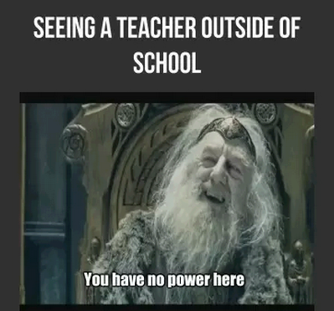
Chapter 13: Leadership, Power, and Negotiation

Slide 2
Agenda
Organizational Politics
Political Skill
Causes & Consequences of Organizational Politics
  Conflict Resolution Style Assessment
Conflict Resolution Styles
Negotiations
  TED Talk: How to Speak Up for Yourself
Alternative Dispute Resolutions
Minute Papers

Slide 3

Organizational Politics
Actions by individuals that are directed toward the goal of furthering their own self interest
Interests can be aligned with or in contrast with the organization

Slide 4


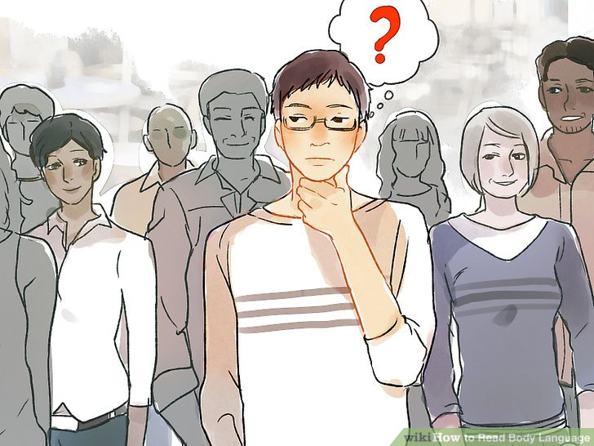

Political Skill
Ability to network
Social astuteness
Interpersonal influence
Apparent sincerity

Slide 5
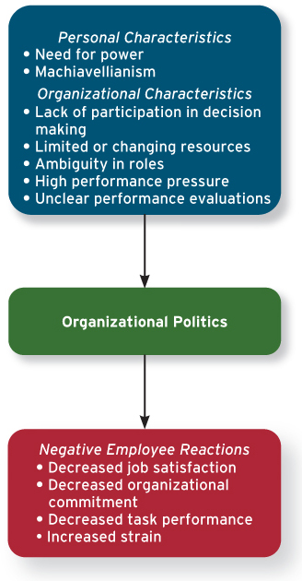
Causes of Org. Politics

Slide 6
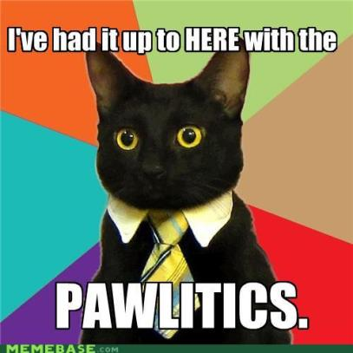
Consequences of Org. Politics

Slide 7
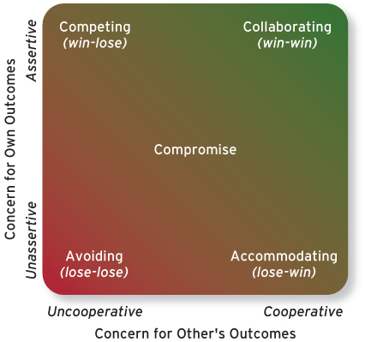
Conflict Resolution Styles

Slide 8
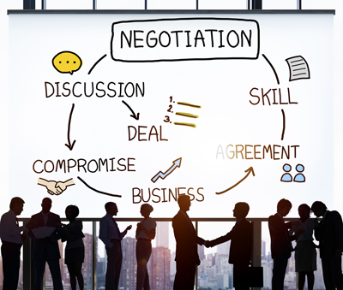
Negotiations
The process in which two or more interdependent individuals discuss and attempt to come to an agreement about their different preferences.
Examples?

Slide 9



Negotiation Strategies:
Distributive bargaining
Integrative bargaining

Slide 10

Negotiation Stages
Preparation
  Knowing your BATNA
Exchanging Information
  Determining your ZOPA
Bargaining
Closing
Commitment

Slide 11

Influences & Biases in Negotiation Process
Perceived power
(or lack of power)
Moods and emotions

Slide 12

TED Talk: How to Speak Up for Yourself
Notes:
https://www.ted.com/talks/adam_galinsky_how_to_speak_up_for_yourself

Slide 13

Alternative Dispute Resolutions (ADR)
In a situation where an agreement is NOT reached, it is called an IMPASSE.
Common ADRs
  Mediation
  Arbitration

Slide 14
Minute Paper
Any questions or clarifications that you have about the topics covered in class that day.
Comments or opinions that you would like to express about the topics covered in class that day.
A statement explaining what you learned in class that day and a way in which you might apply this new knowledge personally.

